Slide 1
Highways Safety Hub
Blue Star award ideas
This presentation includes a selection of innovative ideas / suggestions for improvement

Slide 2
Blue Star awards presentation – Part 3
Overhead and buried services

Slide 3
Intro / background (Slide 1 of 2)
Through the Highways Safety Hub group, an index listing (database) of Blue Star awards and H&S Toolkit ideas has been produced, a summary of initial findings of which reads as follows:
There has not been a vehicle or process in place to integrate innovations and good ideas recognised through the issue of Blue Star awards (and H&S Toolkit ideas), beyond use by respective teams for and by whom the awards were raised
They were just a method of recording innovation, good ideas and good practices observed through a Client led SH&E inspection process
With the passage of time, and changes in work location (projects), personnel and teams, access to knowledge and implementation in use and development of innovation and good ideas raised, may have been lost (or forgotten)
Review of content of Blue Star awards towards the end of 2020, recognised that whilst innovations and good ideas remain, and should always be welcomed and encouraged, many of the topics covered are either dated, out-of-date, now seen as business as usual, superseded by improved processes or systems, or in the case of 2 Blue Star awards, demonstrate that site teams did not fully understand safe operating parameters of the subject matter, i.e. Temporary vehicle restraint barrier.
The word “hindsight” springs to mind here, and criticism of content of any award was and is not intended.
Instead, review of content of the Blue Star awards provides a unique timeline of development across the highways sector, through innovation and learning by all teams, and it is hoped that this continues to be promoted and welcomed

Slide 4
Intro / background (Slide 2 of 2)
Copies of all Blue Star award documents raised to-date, are available on the Highways Safety Hub web site, nested in the alerts tab page; https://www.highwayssafetyhub.com/toolkit.html
A copy of the database of Blue Star awards and H&S Toolkit ideas, hereafter referred to as the “Blue Star awards index listing”, an Excel File, is to be made available on the Highways Safety Hub web site
Content of this presentation includes an index listing of titles of Blue Star awards raised to-date, followed by a selection of ideas, in Blue Star award number
Details of H&S Toolkit ideas (19 off) will be included in a separate presentation

Slide 5
Index listing of Blue Star awards (page 1 of 5)
B000 - Plant person interface, good practice
B001 – Diphoterine
B002 - Traffic management
B003 – Health Wellbeing (Champion)
B004 – Work on bridge deck / Wind monitoring system
B005 – Safetime scaffold tags
B006 – BIM
B007 – RAG batter
B008 – Water mist fire extinguisher
B009 – Smart screens
B010 – Mission Room
B011 – Controlling permits to work
B012 – WAH / Load and unload vehicles
B013 – Gridforce 30
B014 – Dumper camera
B015 – Excavator stickers
B016 – Chapter 8 chevrons
B017 – Occupational health (3 year plan)
B018 – TM airlock
B019 – Health, safety, wellbeing strategy
B020 – Training

Slide 6
Index listing of Blue Star awards (page 2 of 5)
B021 – Readi-guard (RO) TM airlock gates
B022 – Bunkabin accommodation
B023 – Competence
B024 – Technology to improve safety (BIM)
B025 – Red Zone training
B026 – Public route planning
B027 – Safety pegs to maintain TBS zone
B028 – Control of vehicles leaving site
B029 – Vehicle payload and weights sheet
B030 – Message boot laces
B031 – Google maps S&O planning
B032 – LGV enforcement
B033 – HAVwear watches
B034 – LED lights on goal posts
B035 – Briefing document (daily)
B036 – Call button for ped access to site
B037 – QR codes and NFC readers
B038 – Skipper tape exclusion zone
B039 – Value engineering
B040 – Improving communication

Slide 7
Index listing of Blue Star awards (page 3 of 5)
B041 – Incident investigation
B042 – TM (influencing drivers / body cams)
B043 – PatrolLive
B044 – Work behind access and exit points
B045 – Control of HAVS (PAM breaker)
B046 – Safety gates
B047 – Works access gate (WAG)
B048 – Site security)
B049 – A duplication of BS Award 43
B050 – A duplication of BS Award 44
B051 – Animated RAMS
B052 – Yellow mat
B053 – SMART SITE monitors
B054 – Vest and helmet lights
B055 – TM works order management system
B056 – TM nightshift isolation plan
B057 – Service avoidance
B058 – 2-way radios, key info, dumper cam
B059 – Use of stop gates
B060 – Plant person interface training

Slide 8
Index listing of Blue Star awards (page 4 of 5)
B061 – Induction training area 1
B062 – PPI, JCB Hydradig, Prolec restrictors
B063 – LifeVac
B064 – Virtual reality (VR) training
B065 – Rotating dumper cab
B066 – Surface mining (use of Power Plane)
B067 – Occupational health, fatigue
B068 – Service avoidance
B069 – Overhead protection
B070 – Banners (bridge name / No / location)
B071 – Remote drilling (No HAVS)
B072 – MEWP virtual reality training simulator
B073 – Drone tech aerial mapping stockpiles
B074 – Halo Deployment ‘Worker Guardian’
B075 – Base Light 420x portable lighting
B076 – Virtual reality PPI training
B077 – Hi-vis dumper
B078 – Milwaukee 6232 Band saw
B079 – GTL gas to liquids fuel
B080 – VMS overhead protection

Slide 9
Index listing of Blue Star awards (page 5 of 5)
B081 – VMS TM exit
B082 – Trimble site vision
B083 – Survey giraffe
B084 – Public pedestrian safety
B085 – Emergency call button
B086 – V2 VDZ System
Blue Star awards, issued by calendar year:
2015 – 11no.
2016 – 44no. (+2no. Duplicates)
2017 – 12no.
2018 – 11no.
2019 – 2no.
2020 – 3no.
2021 –
Total = 83no.

Slide 10
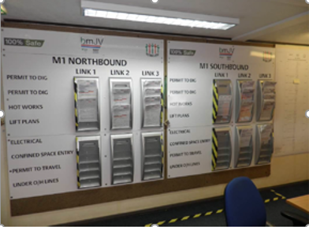
B011 – Controlling permits to work
Various permits to work are issued to cover activities such as excavate/break ground, hot works, confined spaces, and electrical works.
Two Permit Boards have been installed in the main office, which hold the current permits to work for the N/B and S/B carriageways, respectively.
A map of the site is also in place.

Slide 11
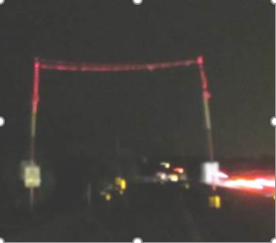
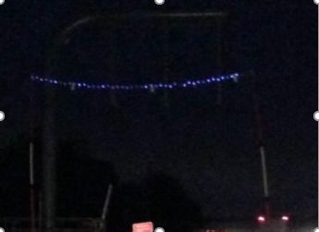
B034 – LED lights on goal posts
Solar LED Flashing lights on the GS6 goal posts for Night-time working.
The LED lights are solar charged and are low voltage which need no maintenance
LED Flashing lights fitted to the top horizontal and 2 vertical legs make them and the height restriction clearly visible.

Slide 12
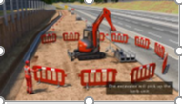
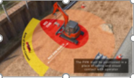
B051 – Animated RAMS
In October 2016, when the Blue Star was awarded, animated RAMS were being developed;
To show the workforce how activities should be carried out safely what equipment should be used, how the work area should be set up, and where operatives should stand etc.
This is particularly useful for briefing to workers who’s 1st language is not English, as it helps to overcome language barriers.

Slide 13
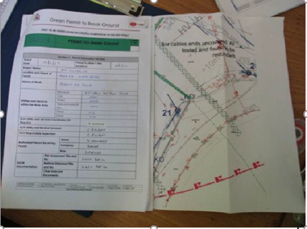
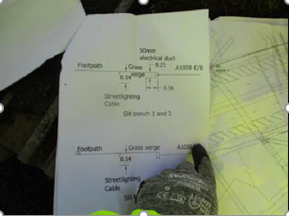
B057 – Service avoidance
Service avoidance –
During initial phase, 208 uncharted services were found in the ground, 64 had been live, pot ended and redundant, left by previous schemes.
A red and green permit system was introduced, requiring a 3 person sign off.
GPR scans were mandatory, and results overlaid onto auto cad drawings, and Vac Excavator has been used.

Slide 14
B068 – Service avoidance
Service avoidance -
Planning and preparation, including:
Review of C2s to ensure, as far as possible, no companies likely to have assets in the area have been missed,
Meet with Utility companies,
Produce and maintain Utility Top 10 issues log,
Log and track utility payments,
Survey of all overhead services
No photos available

Slide 15
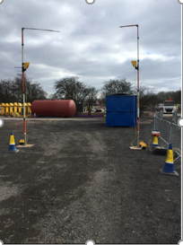
B069 – Over height protection
Over height protection –
New system used for GS6 overhead protection consists of 2 units fastened to the lightweight GRP poles that emit an electronic beam
When the beams are broken an Intellicone sounder is activated and the lights on the unit flash to warn the vehicle or plant operator that they are in breach of the height restriction

